Slide 1







Parity
in TB

Slide 2

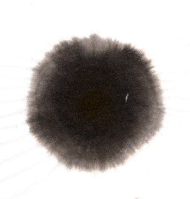
目录
— CONTENTS —
1
能带表示简介
2
ir2tb 接口与使用
3
pz 轨道的尝试

Slide 3
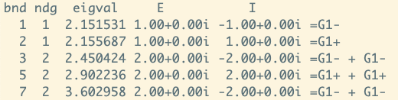
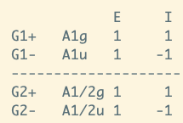

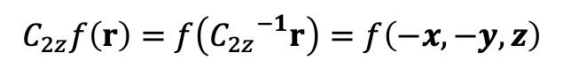
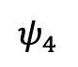

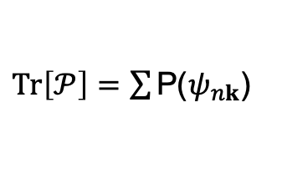
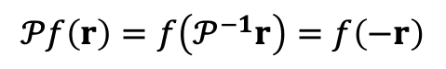
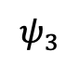
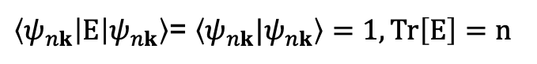

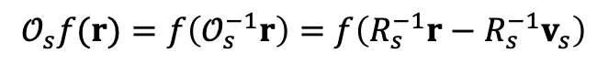
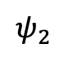


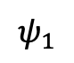
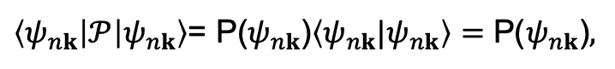
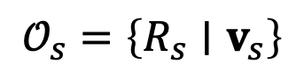
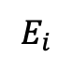
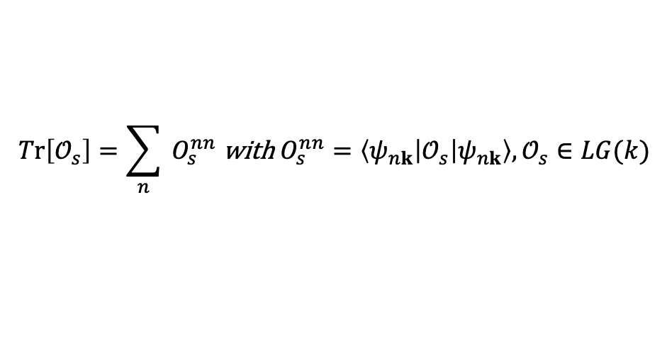
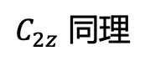
Character in band theory
https://doi.org/10.1016/j.cpc.2020.107760
Space-group operation :
$$𝒪_{s}=\left\{R_{s}∣v_{s}\right\}$$
a rotation part $R_{s}$ and a translation part $v_{s}$
$$𝒪_{s}f(r)=f\left(𝒪_{s}^{−1}r\right)=f\left(R_{s}^{−1}r−R_{s}^{−1}v_{s}\right)$$
$$𝒫f\left(r\right)=f\left(𝒫^{−1}r\right)=f\left(−r\right)$$
$$C_{2z}f\left(r\right)=f\left({C_{2z}}^{−1}r\right)=f\left(−x,−y,z\right)$$
For one eigen state (n-fold degeneracy)
对于 E 来说
$$ψ_{1}$$
$\left\langle ψ_{nk}\left|E\right|ψ_{nk}\right\rangle$= $\left\langle ψ_{nk}|ψ_{nk}\right\rangle =1,Tr\left[E\right]=n$
$$ψ_{2}$$
the character state of a class of operator
对于$𝒫$ 来说
$$E_{i}$$
$${\left[H,𝒫\right]}_{k}=0,$$
$ψ_{nk}$也是$𝒫的本征函数,本征值为±1$
$$ψ_{3}$$
$$\operatorname{Tr}\left[𝒪_{s}\right]=\sum_{n}{ }O_{s}^{nn} \text{with} O_{s}^{nn}=\left\langle ψ_{nk}\left|𝒪_{s}\right|ψ_{nk}\right\rangle ,𝒪_{s}∈LG(k)$$
$$ψ_{4}$$
$\left\langle ψ_{nk}\left|𝒫\right|ψ_{nk}\right\rangle$= P($ψ_{nk}$)$\left\langle ψ_{nk}|ψ_{nk}\right\rangle =\text{P}\text{(}ψ_{nk}\text{)},$
$Tr\left[𝒫\right]=\sum{\text{P}\text{(}ψ_{nk}\text{)}}$
$C_{2z}$ 同理
注意这里的$ψ_{nk}$是广义的
是一些态的线形叠加
在 布洛赫基 与 wannier基下
也略有不同

Slide 4
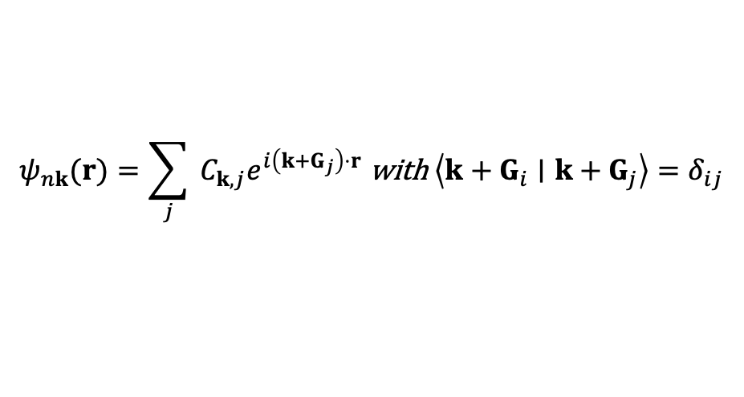
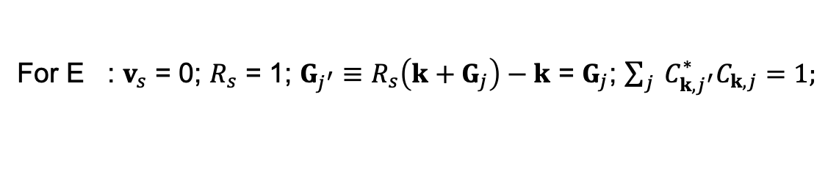
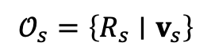
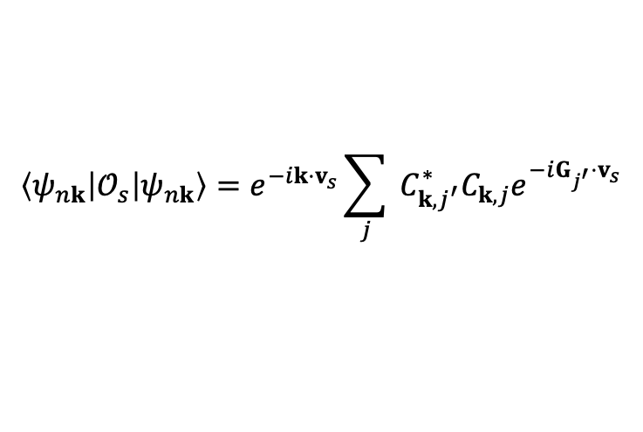
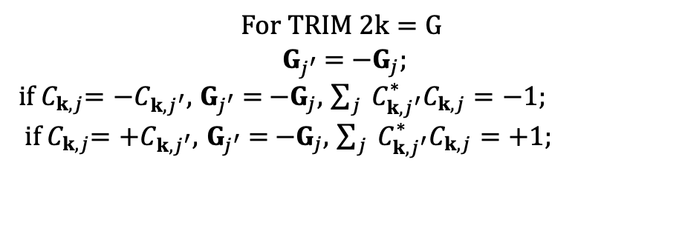
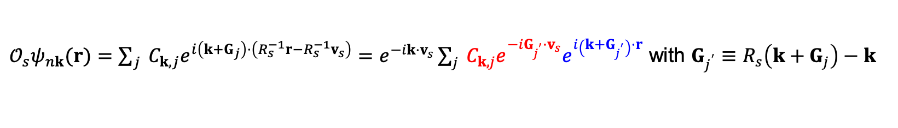
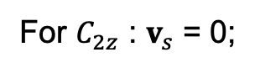
Plane wave basis
irvsp 原理 vasp 的WAVECAR即用的平面波基底
wavefunctions
$$𝒪_{s}=\left\{R_{s}∣v_{s}\right\}$$
$$ψ_{nk}(r)=\sum_{j}{ }C_{k,j}e^{i\left(k+G_{j}\right)⋅r} \text{with} \left\langle k+G_{i}∣k+G_{j}\right\rangle =δ_{ij}$$
Ck,j
VASP WAVECAR中存储的就是这个
$𝒪_{s}ψ_{nk}(r)=\sum_{j}{ }C_{k,j}e^{i\left(k+G_{j}\right)⋅\left(R_{s}^{−1}r−R_{s}^{−1}v_{s}\right)}=e^{−ik⋅v_{s}}\sum_{j}{ }C_{k,j}e^{−iG_{j^{′}}⋅v_{s}}e^{i\left(k+G_{j^{′}}\right)⋅r} \text{with} G_{j^{′}}≡R_{s}\left(k+G_{j}\right)−k$
$$\left\langle ψ_{nk}\left|𝒪_{s}\right|ψ_{nk}\right\rangle =e^{−ik⋅v_{s}}\sum_{j}{ }C_{k,j^{′}}^{∗}C_{k,j}e^{−iG_{j^{′}}⋅v_{s}}$$
For E : $v_{s}$ = 0; $R_{s}$ = 1; $G_{j^{′}}≡R_{s}\left(k+G_{j}\right)−k$ = $G_{j}$; ${\sum_{j}{ }C}_{k,j^{′}}^{∗}C_{k,j}=1;$
For $𝒫$ : $v_{s}$ = 0; $R_{s}$ = -1; $G_{j^{′}}≡R_{s}\left(k+G_{j}\right)−k$ = ${−G}_{j}−2k$;
$$For TRIM 2k=G$$
$G_{j^{′}}$ = ${−G}_{j}$;
if $C_{k,j}$= ${−C}_{k,j^{′}},$ $G_{j^{′}}$ = ${−G}_{j}$, ${\sum_{j}{ }C}_{k,j^{′}}^{∗}C_{k,j}=−1;$
if $C_{k,j}$= ${+C}_{k,j^{′}},$ $G_{j^{′}}$ = ${−G}_{j}$, ${\sum_{j}{ }C}_{k,j^{′}}^{∗}C_{k,j}=+1;$
For $C_{2z}$ : $v_{s}$ = 0;

Slide 5
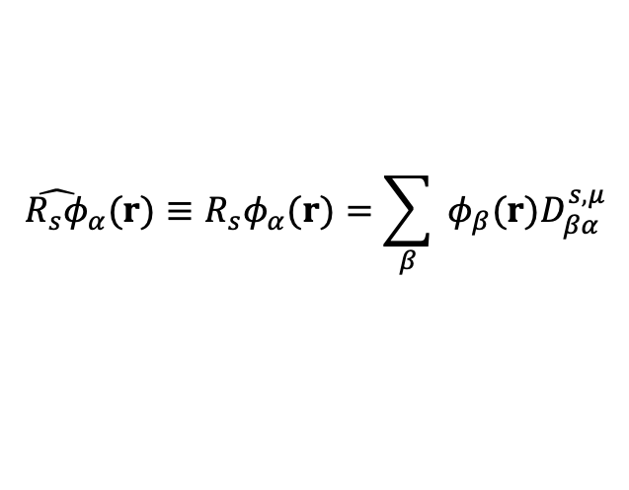
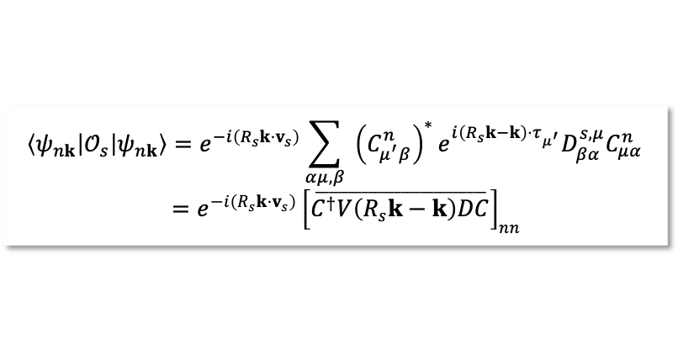
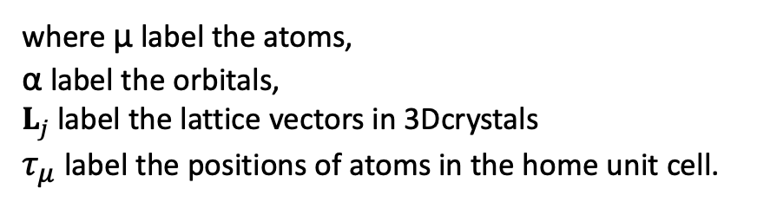
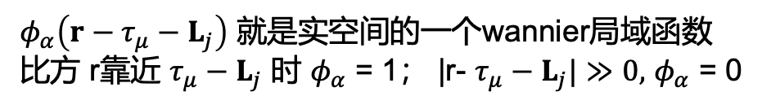
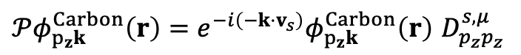
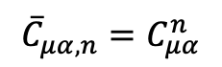
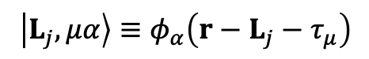
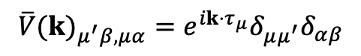
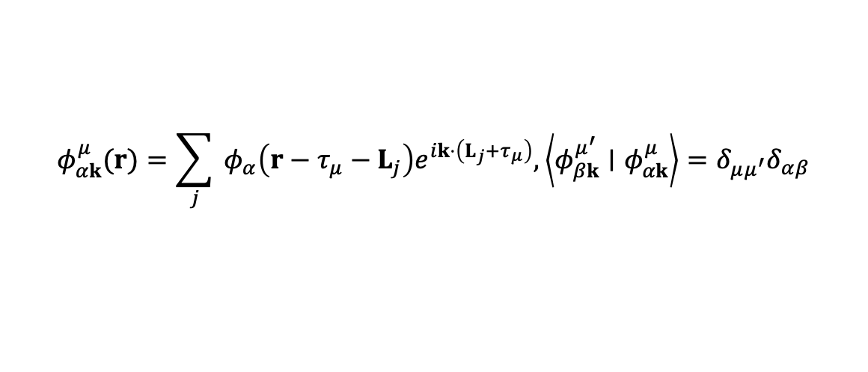
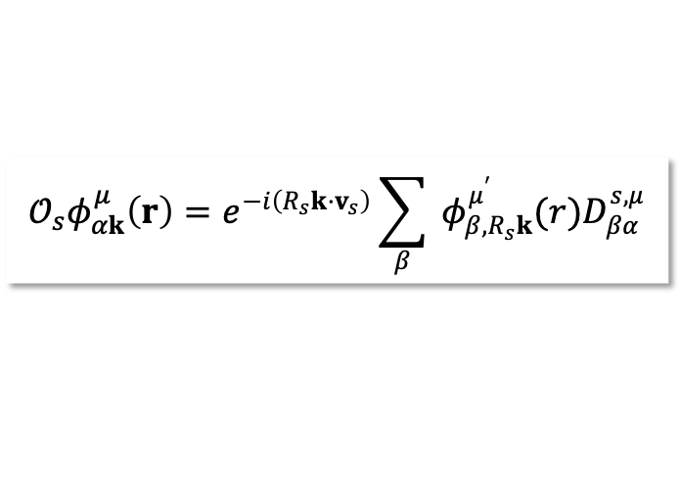
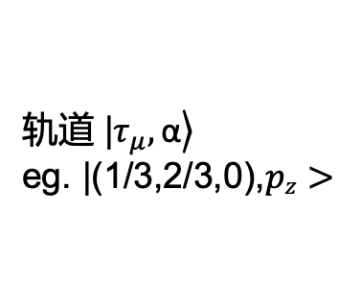
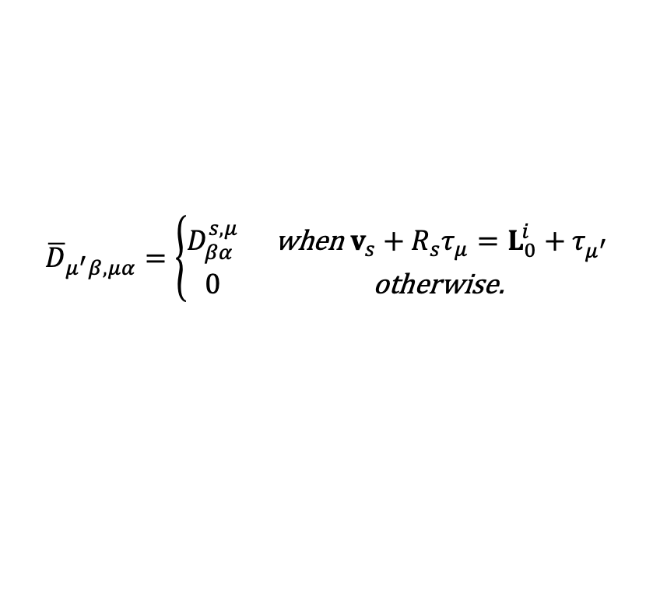
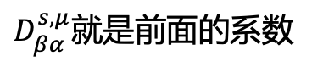
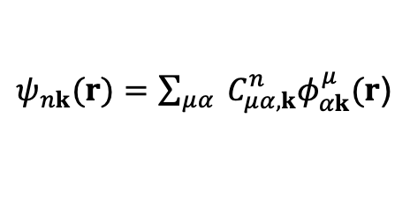
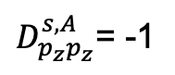
Orthogonal tight-binding basis
$$\left|L_{j},μα\right\rangle ≡φ_{α}\left(r−L_{j}−τ_{μ}\right)$$
$φ_{α}\left(r−τ_{μ}−L_{j}\right)$ 就是实空间的一个wannier局域函数
比方 r靠近 $τ_{μ}−L_{j}$ 时 $φ_{α}$ = 1； |r- $τ_{μ}−L_{j}|≫0,$ $φ_{α}$ = 0
where μ label the atoms,
α label the orbitals,
$L_{j}$label the lattice vectors in 3Dcrystals
$τ_{μ}$label the positions of atoms in the home unit cell.
$$𝒪_{s}φ_{αk}^{μ}\left(r\right)=e^{−i\left(R_{s}k⋅v_{s}\right)}\sum_{β}{ }φ_{β,R_{s}k}^{μ^{′}}(r)D_{βα}^{s,μ}$$
${𝒫φ}_{p_{z}k}^{Carbon}\left(r\right)=$ $e^{−i\left(−k⋅v_{s}\right)}φ_{p_{z}k}^{Carbon}\left(r\right)$ $D_{p_{z}p_{z}}^{s,μ}$
The wavefunction has been written as
$D_{p_{z}p_{z}}^{s,A}$= -1
$ψ_{nk}(r)=\sum_{μα}{ }C_{μα,k}^{n}φ_{αk}^{μ}(r$)
轨道 |$\left.τ_{μ},\text{α}\right\rangle$
eg. |(1/3,2/3,0),$pz>$
$$\left\langle ψ_{nk}\left|𝒪_{s}\right|ψ_{nk}\right\rangle =e^{−i\left(R_{s}k⋅v_{s}\right)}\sum_{αμ,β}{ }{\left(C_{μ^{′}β}^{n}\right)}^{∗}e^{i\left(R_{s}k−k\right)⋅τ_{μ^{′}}}D_{βα}^{s,μ}C_{μα}^{n}$$
$=e^{−i\left(R_{s}k⋅v_{s}\right)}{\left[\overset{__________________________}{C^{†}V\left(R_{s}k−k\right)DC}\right]}_{nn}$
某个本征态 对轨道的展开系数
石墨烯的一个pz轨道
$$φ_{αk}^{μ}(r)=\sum_{j}{ }φ_{α}\left(r−τ_{μ}−L_{j}\right)e^{ik⋅\left(L_{j}+τ_{μ}\right)},\left\langle φ_{βk}^{μ^{′}}∣φ_{αk}^{μ}\right\rangle =δ_{μμ^{′}}δ_{αβ}$$
$${\overline{V}(k)}_{μ^{′}β,μα}=e^{ik⋅τ_{μ}}δ_{μμ^{′}}δ_{αβ}$$
轨道不同
元素不同 = 0
Rvector 每个轨道需要对所有HR中该轨道求和
$${\overline{C}}_{μα,n}=C_{μα}^{n}$$
WAVEFUNC系数
实空间波函数傅立叶变换
$${\overline{D}}_{μ^{′}β,μα}=\left\{\begin{matrix}D_{βα}^{s,μ} & \text{when} v_{s}+R_{s}τ_{μ}=L_{0}^{i}+τ_{μ^{′}} \\ 0 & \text{otherwise}\text{. }\end{matrix}\right.$$
$${\hat{R_{s}φ}}_{α}(r)≡R_{s}φ_{α}(r)=\sum_{β}{ }φ_{β}(r)D_{βα}^{s,μ}$$
$D_{βα}^{s,μ}$就是前面的系数
比方 C3 回把${ φ}_{α}\left(r\right)=px 转变成{{ φ}_{α}\left(r\right)+φ}_{β }\left(r\right)=py$

Slide 6
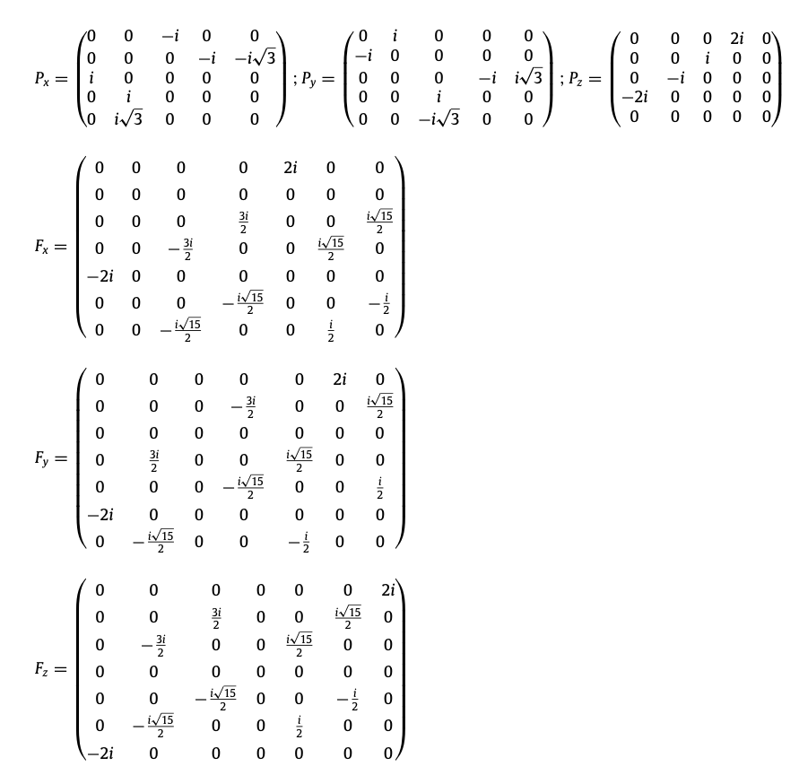
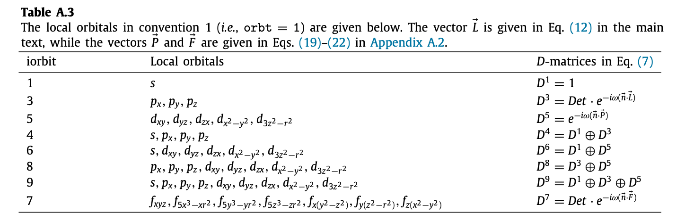
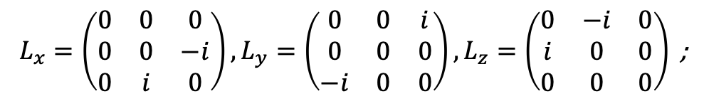
D-matrices
$$L_{x}=\left(\begin{matrix}0 & 0 & 0 \\ 0 & 0 & −i \\ 0 & i & 0\end{matrix}\right),L_{y}=\left(\begin{matrix}0 & 0 & i \\ 0 & 0 & 0 \\ −i & 0 & 0\end{matrix}\right),L_{z}=\left(\begin{matrix}0 & −i & 0 \\ i & 0 & 0 \\ 0 & 0 & 0\end{matrix}\right)\text{ ;}$$
P： D(px) = D(px) = D(pz) = -1
C2： D(px) = D(px) = -1
D(pz) = 1

Slide 7
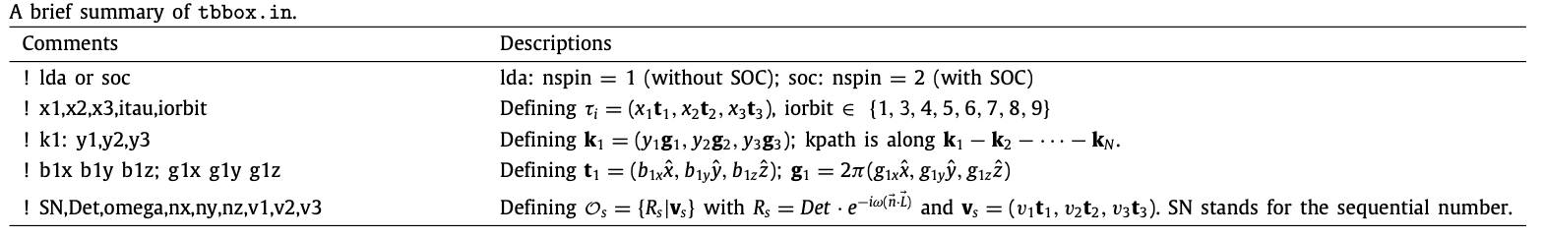
ir2tb 使用条件
一个有对称性的 hr.dat : case_hr.dat
合适的 输入文件: tbbox.in
parkman@time:ex_bi2se3_lda$ ir2tb_1
case = lda ! lda or soc 加不加SOC spinful or not
proj:
orbt = 2 ! orbtype
ntau = 5 ! 几个 site
0.39900000 0.39900000 0.39900000 1 3 ! x1, x2, x3, itau, iorbit
0.60100000 0.60100000 0.60100000 1 3 ! itau 指标第几个原子
0.20600000 0.20600000 0.20600000 2 3 ! iorbit 指标什么类型的轨道
0.79400000 0.79400000 0.79400000 2 3
0.00000000 0.00000000 0.00000000 2 3
end projections
kpoint:
kmesh = 1
Nk = 4 ! 我要读四行
0.00000000 0.00000000 0.00000000 ! k0: y1,y2,y3
0.50000000 0.50000000 0.50000000 ! k1
0.50000000 0.50000000 0.00000000 ! k2
0.00000000 0.50000000 0.00000000 ! k3
end kpoint_path
unit_cell:
1.194537707 -2.069000000 9.546666657 0.139523990 -0.241662639 0.034916201
1.194537707 2.069000000 9.546666657 0.139523990 0.241662639 0.034916201
-2.389075414 0.000000000 9.546666657 -0.279047979 0.000000000 0.034916201
1 1.000000 0.000000 1.000000 0.000000 0.000000 0.000000 0.000000 0.000000
2 -1.000000 0.000000 1.000000 0.000000 0.000000 0.000000 0.000000 0.000000
end unit_cell_cart
********************************************************************************
knum = 0 kname=
k = 0.000000 0.000000 0.000000
The point group is Ci
2 symmetry operations in 2 classes
Table 6 on page 32 in Koster et al [7]
Table 11.4 on page 138 in Altmann et al [8]
E I
G1+ A1g 1 1
G1- A1u 1 -1
--------------------
G2+ A1/2g 1 1
G2- A1/2u 1 -1
class, symmetry ops, exp(-i*k*taui)
E 1 (+1.00 0.00i)
I 2 (+1.00 0.00i)
bnd ndg eigval E I
1 1 2.151531 1.00+0.00i -1.00+0.00i =G1-
2 1 2.155687 1.00+0.00i 1.00+0.00i =G1+
3 2 2.450424 2.00+0.00i -2.00+0.00i =G1- + G1-
5 2 2.902236 2.00+0.00i 2.00+0.00i =G1+ + G1+
7 2 3.602958 2.00+0.00i -2.00+0.00i =G1- + G1-
9 1 4.561219 1.00+0.00i -1.00+0.00i =G1-
10 1 4.744623 1.00+0.00i 1.00+0.00i =G1+
11 2 5.673028 2.00+0.00i 2.00+0.00i =G1+ + G1+
13 1 7.024584 1.00+0.00i -1.00+0.00i =G1-
14 2 7.220439 2.00+0.00i -2.00+0.00i =G1- + G1-
********************************************************************************
Orbital convertion 1: s, px, py, pz, xy, yz, zx, x2-y2, 3z2-r2 !!!
Orbital convertion 2: s, pz, px, py, 3z2-r2, xz, yz, x2-y2, xy (Wannier90) !!!
直接复制 OUTCAR
这里我们保留的是 E,P

Slide 8
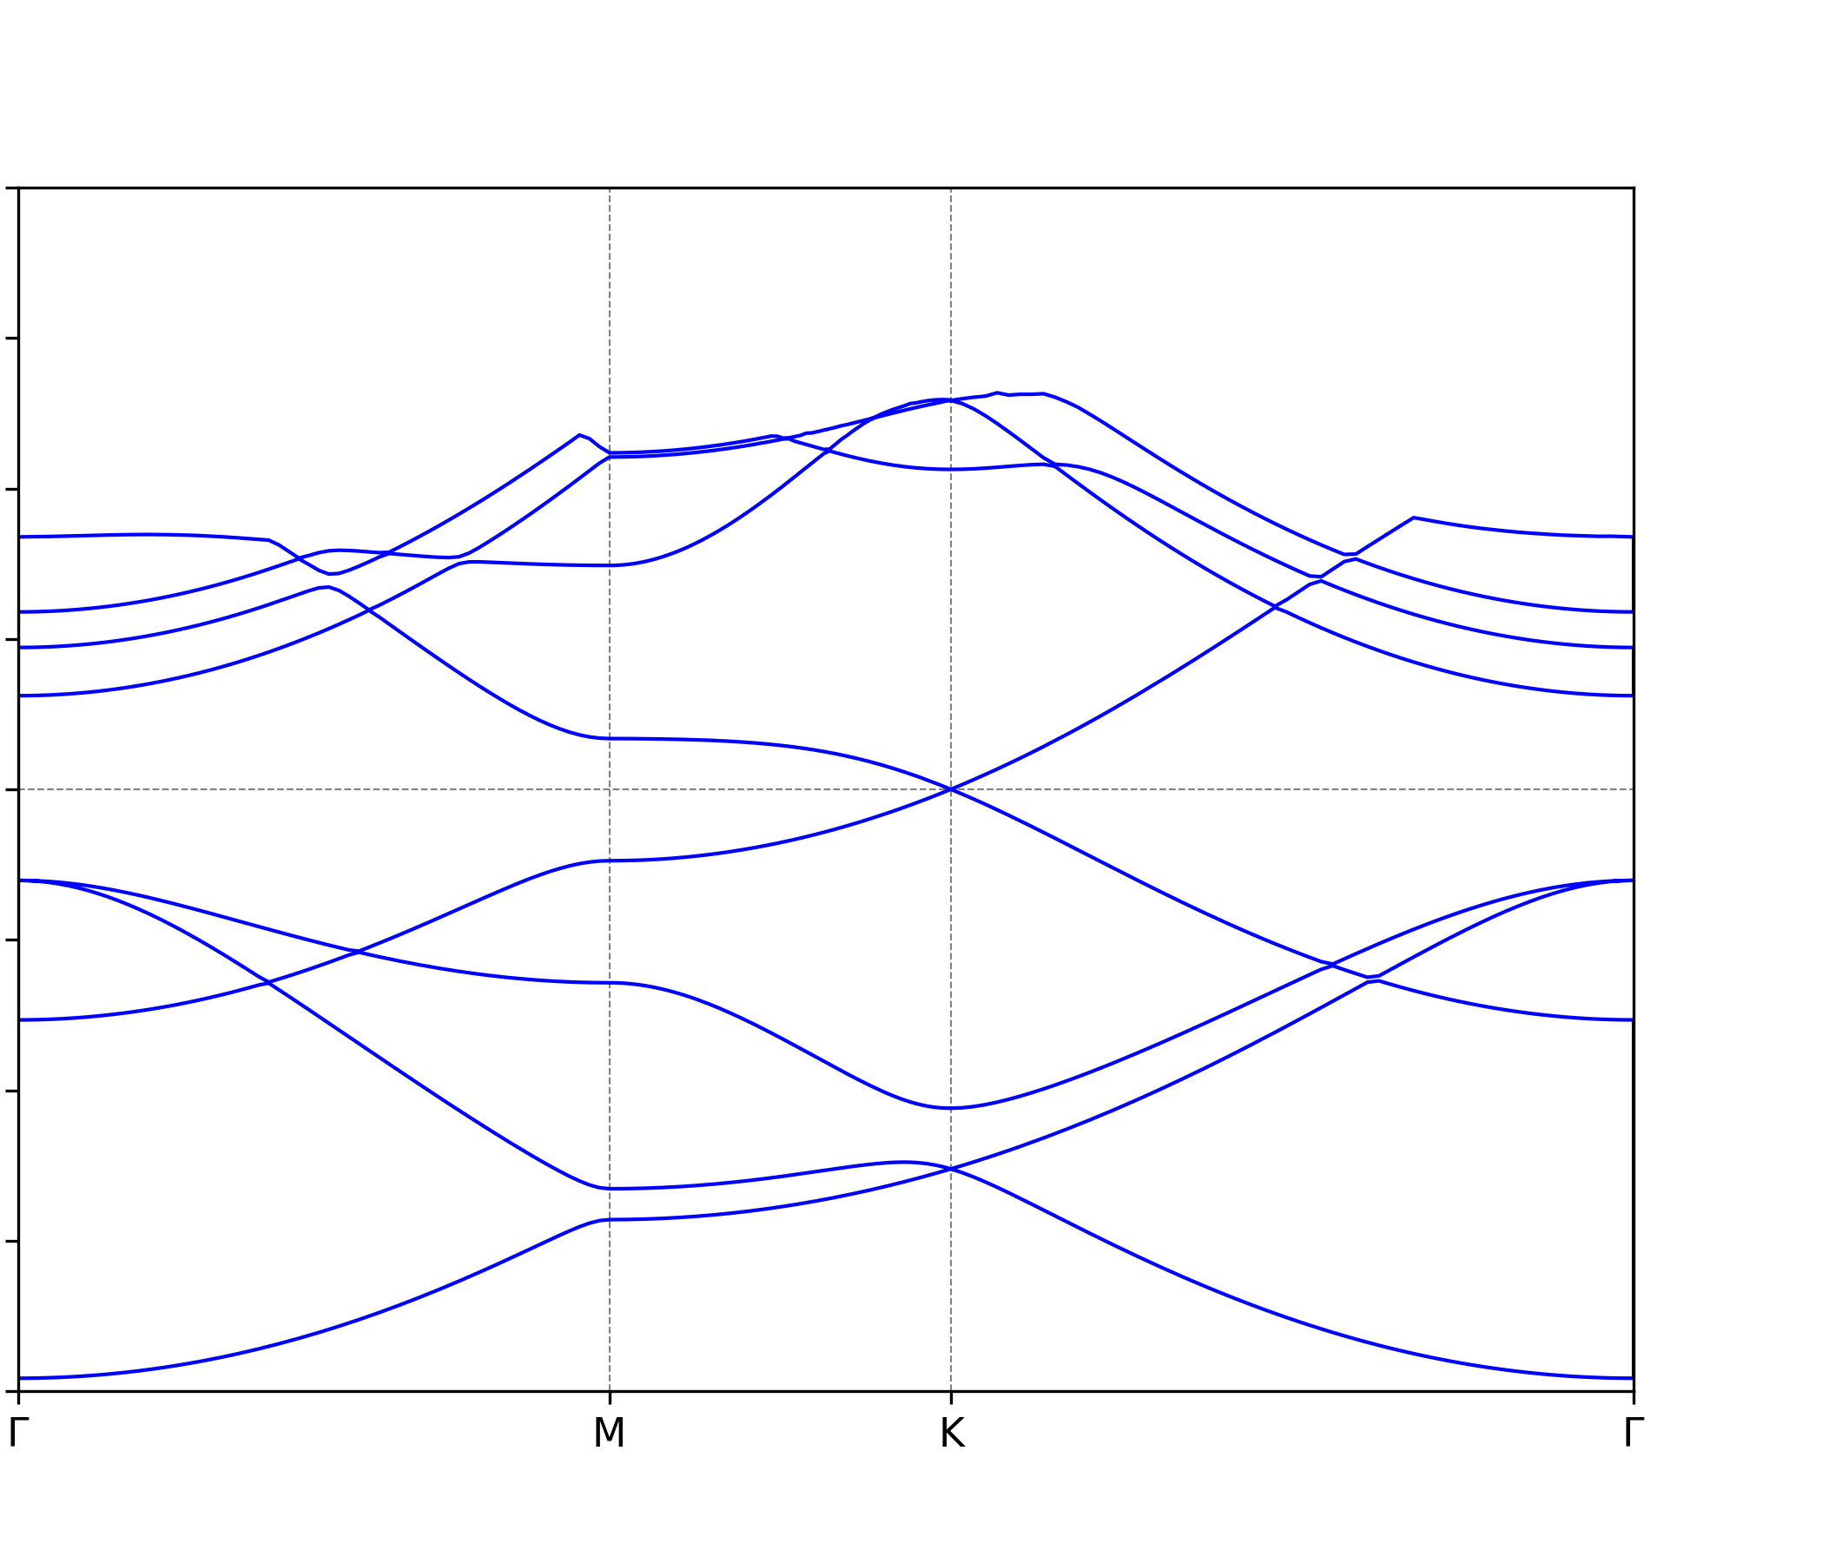
Graphene test
* DFT ref
tbbox.in
irvsp: bug 在INCAR中必须设定SYSTEM name
proj:
orbt = 1
ntau = 2
0.6666666666666666 0.3333333333333333 0.0000000000000000 1 4
0.3333333333333334 0.6666666666666667 0.0000000000000000 1 4
end projections
G1+
G5
G1+
G6+
G4+
G6+
G2-
G1
G2-
G3-
G3-
G6
G1+
G1+
G4+
G6
G4+
D6h
D2h
D3h
D6h
G5-
G5-
G4+
G5
E_onsite_2_0 = -3.6842;
E_onsite_2_1 = 0
VppS_1 = -4.2889;
VppP_1 = 2.72769
VspS_1 = -5.1197
VssS_1 = 5.2939;
Fermi = 0.00;
G6+
G6+
G2-
G4-
G1
G2-
G1+
G2-
G6
G1+
G1+
D6h
D2h
D3h
D6h

Slide 9
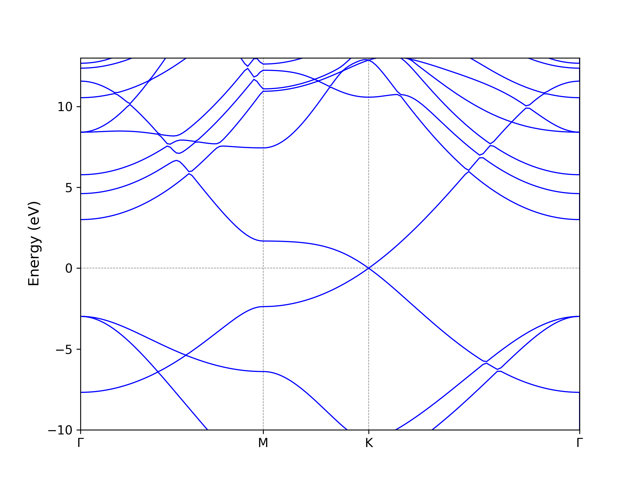
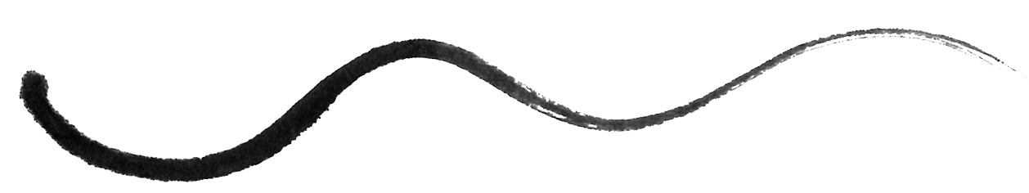
case = lda ! lda or soc
proj:
orbt = 1
ntau = 2
0.6666666666666666 0.3333333333333333 0.0000000000000000 1 1
0.3333333333333334 0.6666666666666667 0.0000000000000000 1 1
end projections
kpoint:
kmesh = 1
Nk = 4
0.00000000 0.00000000 0.00000000 ! k0: y1,y2,y3
0.50000000 0.00000000 0.00000000 ! k1
0.33333330 0.33333330 0.00000000 ! k2
0.00000000 0.00000000 0.00000000 ! k3
end kpoint_path
unit_cell:
2.460439920 0.000000000 0.000000000 0.406431383 0.234653268 0.000000000
-1.230219960 2.130803476 0.000000000 0.000000000 0.469306537 0.000000000
0.000000000 0.000000000 10.000000000 0.000000000 0.000000000 0.100000000
1 1.000000 0.000000 1.000000 0.000000 0.000000 0.000000 0.000000 0.000000
2 -1.000000 0.000000 1.000000 0.000000 0.000000 0.000000 0.000000 0.000000
end unit_cell_cart
G1-
G1-
当作s轨道
所有 parity * -1即可
G1+
G1-
G1+
G1+
DFT
G1+
G1+
/irot
G1-
G1+
G1-
G1-

Slide 10
A modified version of ir2tb (by parkman)
proj:
orbt = 1
ntau = 2
0.6666666666666666 0.3333333333333333 0.0000000000000000 1 1
0.3333333333333334 0.6666666666666667 0.0000000000000000 1 1
end projections
原本1表示s轨道
现在1表示pz轨道
修改源码 init.F
if(n2obtau(itau)==1) then
rotjorb(1,1,itau,irot)=real(protmt(3,3),dp)!cmplx(1.d0,0.d0,dp)
IF(rtmp(1).lt. 1.d-2) rotjorb(1,1,itau,irot)=-real(protmt(3,3),dp)
parkman@time:pz_test$ ir2tb_pz
knum = 0 kname=
k = 0.000000 0.000000 0.000000
The point group is Ci
2 symmetry operations in 2 classes
Table 6 on page 32 in Koster et al [7]
Table 11.4 on page 138 in Altmann et al [8]
E I
G1+ A1g 1 1
G1- A1u 1 -1
--------------------
G2+ A1/2g 1 1
G2- A1/2u 1 -1
class, symmetry ops, exp(-i*k*taui)
E 1 (+1.00 0.00i)
I 2 (+1.00 0.00i)
bnd ndg eigval E I
1 1 -8.183070 1.00+0.00i -1.00+0.00i =G1-
2 1 8.183070 1.00+0.00i 1.00+0.00i =G1+
若用满对称性
和DFT结果一致
G1+
G1+
G4+
G4+
G1-
G2-
G1+
G4+
G1-
G1-
G2-
G2-
如有需要可以稍作调整 作出： ir2tb_pxpy

Slide 11
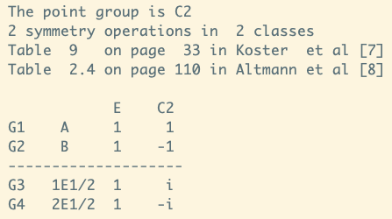
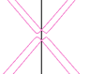
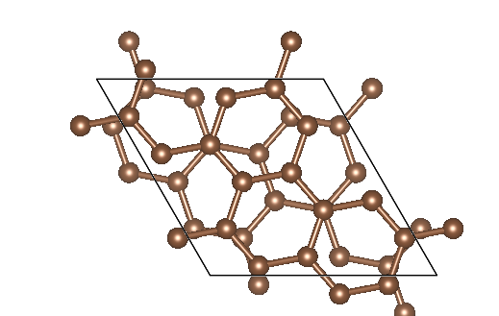
TBSK TBG RCN Calculation & 自动生成 tbbox.in 文件
（-6 + -8*3 ）/2 mod 2 = 1
k = 0.000000 0.000000 0.000000
bnd ndg eigval E C2
1 1-12.672149 1.00+0.00i 1.00+0.00i =G1
2 1 -7.495314 1.00+0.00i 1.00+0.00i =G1
3 1 -4.519752 1.00+0.00i 1.00+0.00i =G1
4 2 -4.449196 2.00+0.00i -2.00+0.00i =G2 + G2
6 1 -4.378744 1.00+0.00i -1.00+0.00i =G2
7 2 -4.374895 2.00+0.00i 2.00+0.00i =G1 + G1
9 1 -2.339717 1.00+0.00i -1.00+0.00i =G2
10 2 -2.332344 2.00+0.00i 2.00+0.00i =G1 + G1
12 2 -2.260934 2.00+0.00i -2.00+0.00i =G2 + G2
14 1 -2.186501 1.00+0.00i 1.00+0.00i =G1
k = 0.500000 0.000000 0.000000
bnd ndg eigval E C2
1 1 -9.975976 1.00+0.00i 1.00+0.00i =G1
2 1 -9.964767 1.00+0.00i -1.00-0.00i =G2
3 1 -5.949124 1.00+0.00i 1.00+0.00i =G1
4 1 -5.939192 1.00+0.00i -1.00-0.00i =G2
5 1 -5.849436 1.00+0.00i -1.00-0.00i =G2
6 1 -5.842201 1.00+0.00i 1.00+0.00i =G1
7 1 -3.302356 1.00+0.00i -1.00-0.00i =G2
8 1 -3.291330 1.00+0.00i 1.00+0.00i =G1
9 1 -2.229872 1.00+0.00i -1.00-0.00i =G2
10 1 -2.150658 1.00+0.00i -1.00-0.00i =G2
11 1 -1.110175 1.00+0.00i 1.00+0.00i =G1
12 1 -0.692852 1.00+0.00i 1.00+0.00i =G1
13 1 -0.684786 1.00+0.00i -1.00-0.00i =G2
14 1 -0.323143 1.00+0.00i -1.00-0.00i =G2
-6
-8

Slide 12
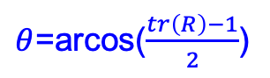





旋转矩阵
向量旋转公式最早由法国数学家本杰明·奥伦德·罗德里格(Benjamin Olinde Rodrigues(1795–1851))导出
v是在 R3 中的向量， k 是与转轴同向的单位向量， theta 是 v 绕 k 的右手方向旋转经过的角度
$$\left.v_{rot}=vcos{θ}+(k×v)sin{θ}+k(k⋅v)(1−cos{θ}\right)$$
$$\begin{aligned}v_{rot}=Rv→ \\ R=v^{−1}vcos{θ}+v^{−1}(k×v)sin{θ}+v^{−1}k(k⋅v)(1−cos{θ}) \\ =\cos{θ}I+{\left(1−\cos{θ}\right)kk}^{T}+v^{−1}(k×v)\sin{θ} \\ =\cos{θ}I+{\left(1−\cos{θ}\right)nn}^{T}+\sin{θ Skew}(n)\end{aligned}$$
Skew$\left(n\right)=\left(\begin{matrix}0 & −n_{z} & n_{y} \\ n_{z} & 0 & −n_{x} \\ −n_{y} & n_{x} & 0\end{matrix}\right)$
$$n=\left[\begin{aligned}&n_{x} \\ &n_{y} \\ &n_{z}\end{aligned}\right]=\frac{1}{2sin{θ}}\left[\begin{aligned}&\left.R(2,1)−R(1,2\right) \\ &\left.R(0,2)−R(2,0\right) \\ &\left.R(1,0)−R(0,1\right)\end{aligned}\right]$$
$θ$=arcos($\frac{tr\left(R\right)−1}{2}$)
$$R=\left[\begin{matrix}n_{x}^{2}+\left(1−n_{x}^{2}\right)cosθ & n_{x}n_{y}(1−cosθ)−n_{z}sinθ & n_{x}n_{z}(1−cosθ)+n_{y}sinθ \\ n_{x}n_{y}(1−cosθ)+n_{z}sinθ & n_{y}^{2}+\left(1−n_{y}^{2}\right)cosθ & n_{y}n_{z}(1−cosθ)−n_{x}sinθ \\ n_{x}n_{z}(1−cosθ)−n_{y}sinθ & n_{y}n_{z}(1−cosθ)+n_{x}sinθ & n_{z}^{2}+\left(1−n_{z}^{2}\right)cosθ\end{matrix}\right]$$

Slide 13
谢谢

